Slide 1
Early warning systems in the Urban setting- A Caribbean Perspective
Organization of American States
Sustainable Cities
2 December 2014

Slide 2
Characteristics of the Caribbean
Most states are Small Island Developing States (SIDS) and countries with large low-lying coastal areas that are vulnerable to flooding;
Significant coastal socio-economic development with most major cities, capitals and financial centres located in coastal areas;
Mostly agricultural and service based economies with few exceptions;
Integrated regional economies that lack significant diversity;
Complex but similar environmental hazards (e.g., flooding, drought, wind, earthquake) and highly vulnerable populations & ecosystems
Acutely susceptible to climate change and climate variability;
All countries trying achieve the UN Millennium Development

Slide 3
Natural Disasters in the Caribbean
Caribbean countries, by virtue of their geographical characteristics, resource constraints and limited adaptive capacity, are vulnerable to natural hazards, especially hydro-meteorological events such as tropical storms, hurricanes and heavy rainfall.
Between 1990 and 2008, the Caribbean experienced 165 natural disasters, of which 61% were windstorm-related events – hurricanes, floods and tropical storms.
The total impact on the sub-region (in damage and losses) was estimated at US $ 136 billion over the period.
ECLAC: LC/CAR/L.254, 2010

Slide 4
Caribbean Climate
The Caribbean climate is tropical, moderated to a certain extent by the prevailing northeast trade winds.
Individual climatic conditions are strongly dependent on elevation.
At sea level there is little variation in temperature, regardless of the time of the day or the season of the year. Temperatures range between 24°C and 32°C.
Daylight hours tend to be shorter during summer and slightly longer during winter than in the higher latitudes.

Slide 5
Caribbean Climate cont’d
The rainy season from May through October and the dry season, corresponding to winter in the northern hemisphere.
Even during the rainy period, the precipitation range fluctuates greatly. Windward sides of islands with mountains receive much rain, whereas leeward sides can have very dry conditions.
Flat islands receive slightly less rainfall, but its pattern is more consistent.

Slide 6
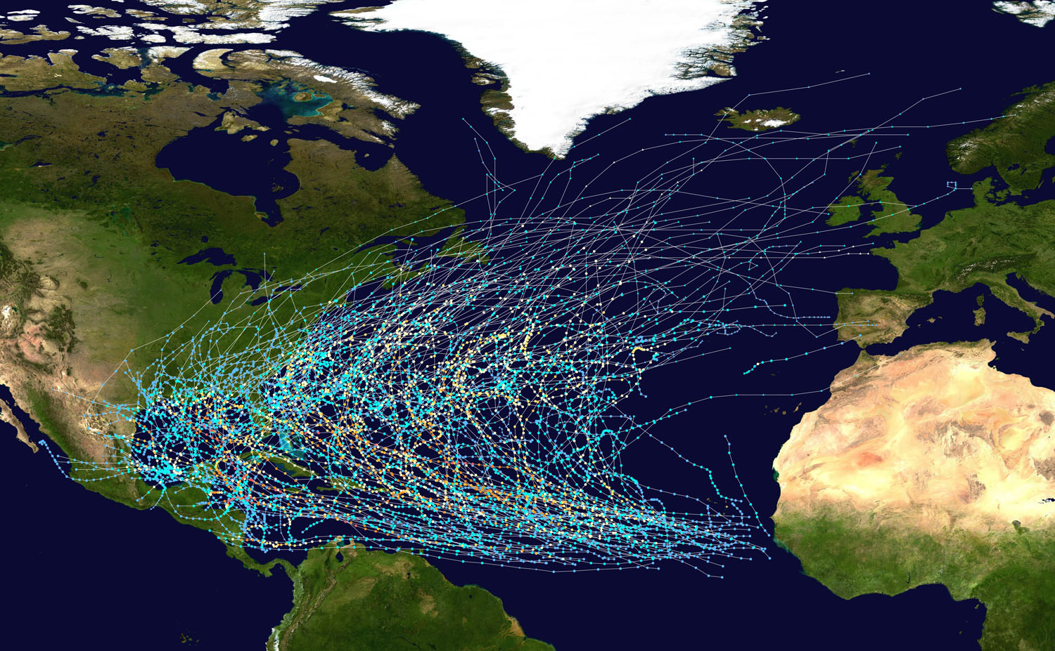
Atlantic Basin Hurricane tracks 1980-2005

Slide 7
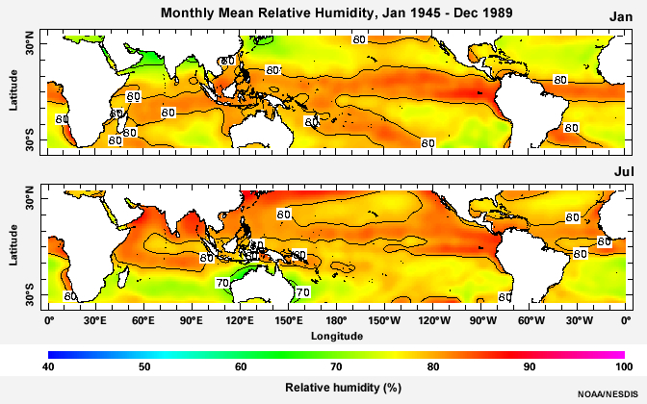
Annual Radiation Budget
Introduction to Meteorology

Slide 8
Present Early Warning Systems
Meteorological Services in the region operate an early warning system for the following hydro-meteorological phenomena:
Tropical Cyclones (storms and hurricanes)
Floods
Droughts
Severe weather
Rough Seas

Slide 9
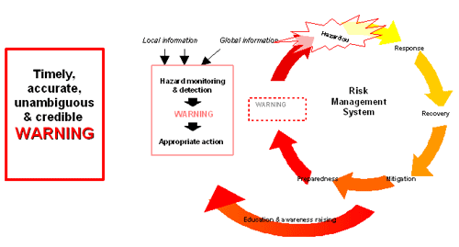
Characteristics of an EWS

Slide 10
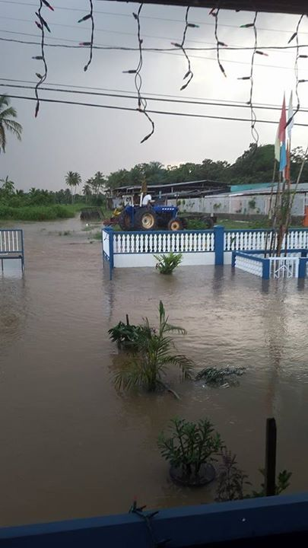
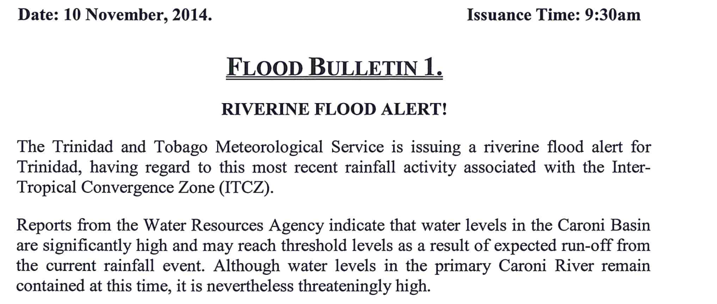
Problems with Present EWS
Alerts and warnings are too broad based
Recipients do not take appropriate actions.

Slide 11
Impact Forecasting
Timely provision of information on critical climatic parameters:
Precipitation, temperature, relative humidity, wind speed and direction
Who will be impacted, when and for how long?
Some people may not be able to go back to their communities for dome time.

Slide 12
Impact Forecasting cont’d
Data quality is important if risk reduction is to be achieved
Measurement networks must exist, be appropriate to the scale of the problem, and work for long periods of time
Data quality assurance and quality control are important
Products and information derived data must be transferred to stakeholders in a form that can be readily used ... needs and capabilities of downstream users must be understood.

Slide 13
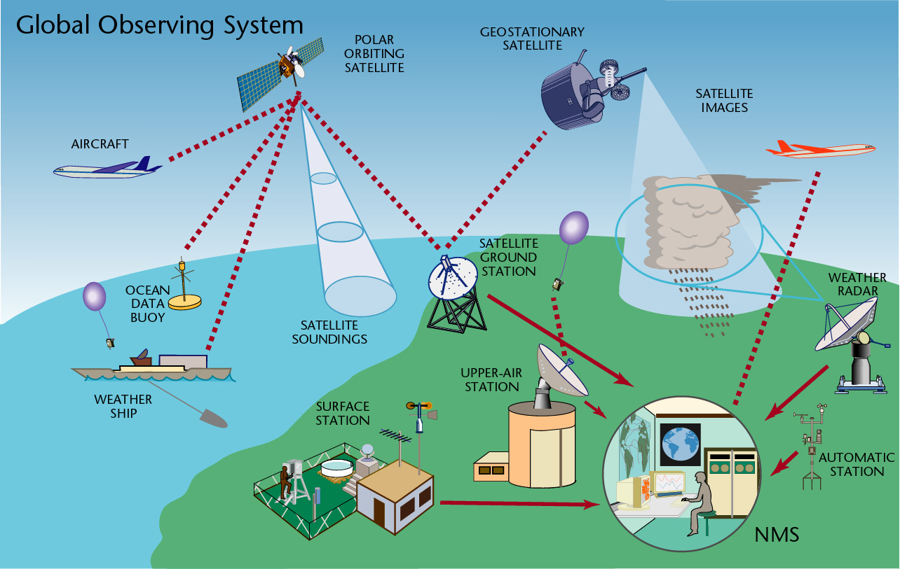

Slide 14
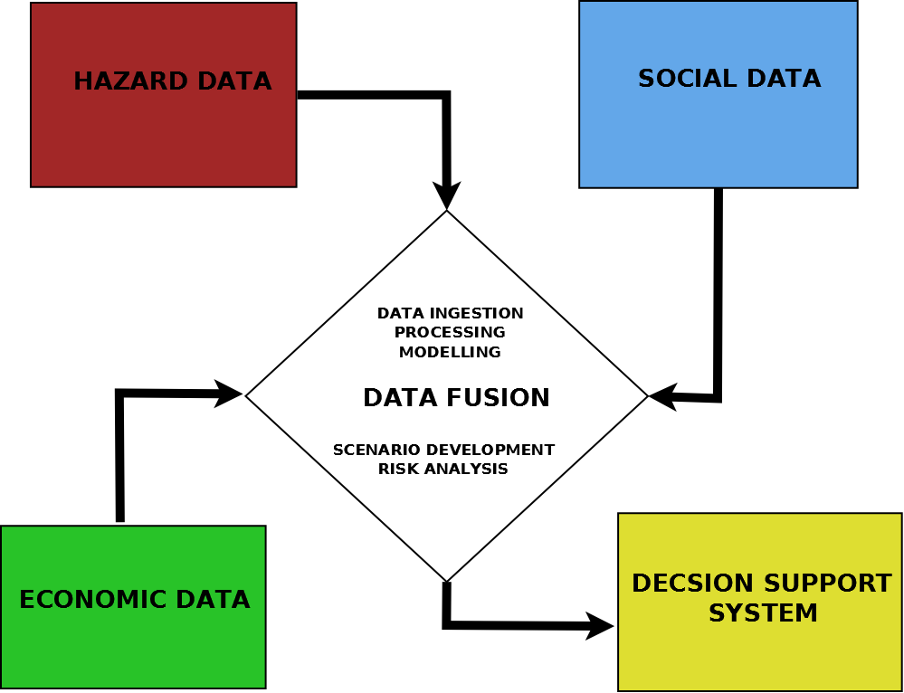
Impact Forecasting Model

Slide 15
Hazard Data
Historical Information on impacts of extreme events e.g. (floods: - where, height of water, extend of the flood.)
Topography
Numerical weather products
Data from satellites, observation networks including radar data if available;

Slide 16
Social Data
Vulnerability of different communities to the impacts of different hydrometeorlogical events;
Environmental data about each community (land use, infrastructure mapping, drainage systems);
Information on the social make-up of the communities (e.g. gender, ethnicity, age groups etc.)
Population and demographic data

Slide 17
Economic data
Vulnerability may also vary in its forms: poverty, for example, may mean that housing is unable to withstand an earthquake or a hurricane, or lack of preparedness may result in a slower response to a disaster, leading to greater loss of life or prolonged suffering.
Provide data which would planners to determine the resilience of the community.

Slide 18
Decision Support System
It is clear that an Early warning system which provides “Impact Forecasting” goes beyond the ability of the “Meteorologist” who is only qualified and competent in the field of meteorology.
Impact forecasting requires the expertise:
Disaster managers;
Social scientists;
Urban planners;
Hydrologists, etc.
Therefore one can either have a team which deals with early warning or have the data and tools reside in a portal which can layer the information for disaster managers.

Slide 19
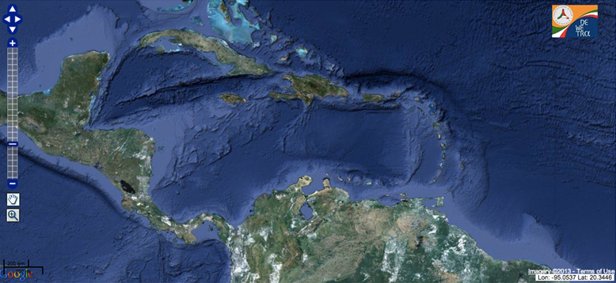
HAZARD DATA
Base Map

Slide 20
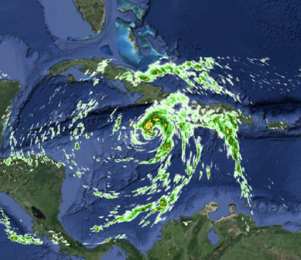
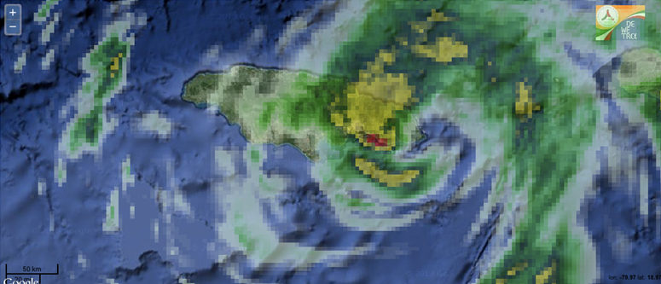
HAZARD DATA
Base Map + Satellite Image
Base Map + model output

Slide 21
THANK YOU

